Slide 1
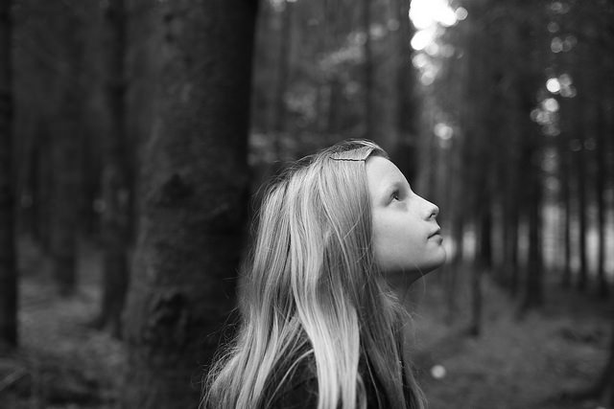
I Imagine….
By Chantelle Roy

Slide 2
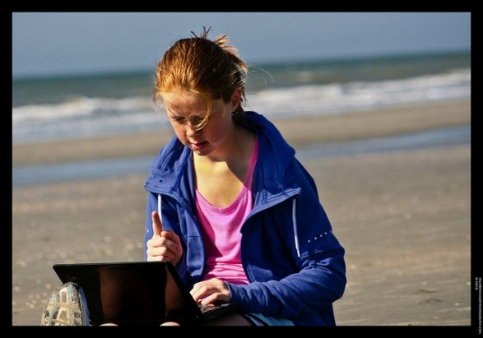
Freedom from walls…
Freedom from walls…

Slide 3
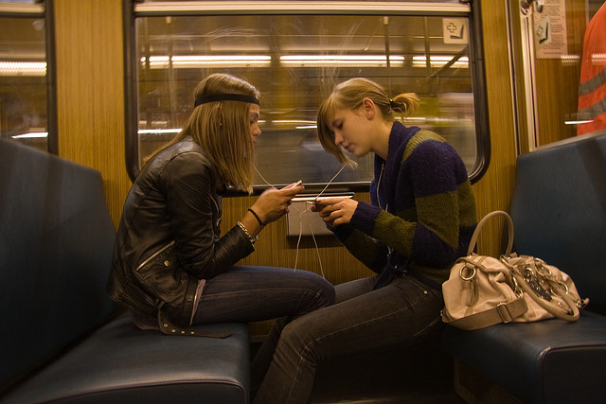
Freedom to share…

Slide 4
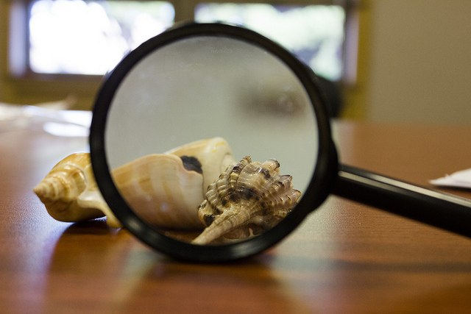
Freedom to discover….

Slide 5
Freedom to dream…

Slide 6
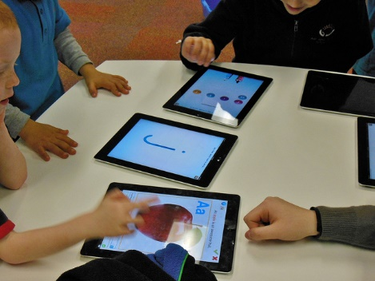
Learning as play…

Slide 7
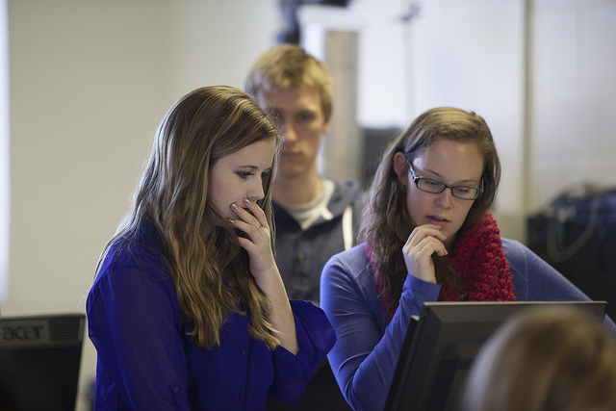
Encouraging thought…

Slide 8
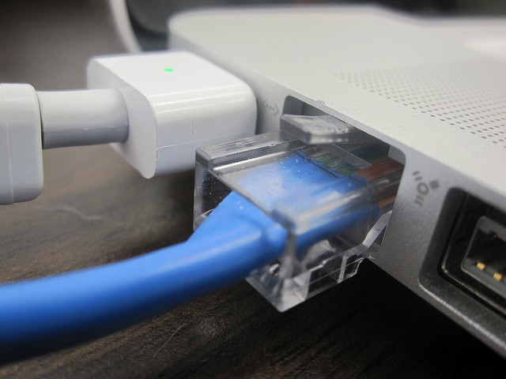
Connecting to the world…

Slide 9
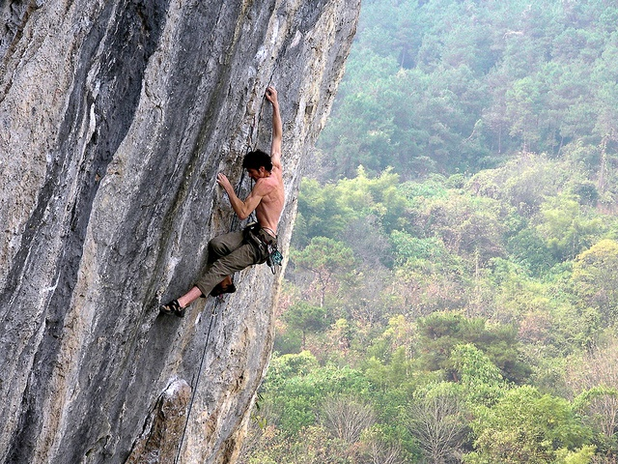
Reaching beyond limits…

Slide 10
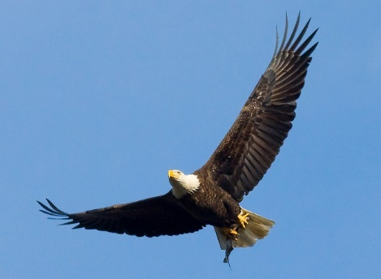
Soaring high…

Slide 11
Finding success…

Slide 12
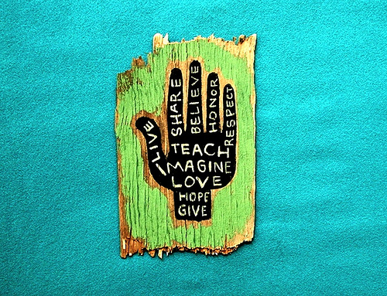
I imagine…
Teaching online.

Slide 13
Sources (Used Without Permission)
http://tinyurl.com/q3qkubl
http://tinyurl.com/q8owjcg
http://tinyurl.com/qdlcwyw
http://tinyurl.com/q9ayf66
http://tinyurl.com/qazvrdc
http://tinyurl.com/opx7qym
http://tinyurl.com/prgbsxu
http://tinyurl.com/qzvjcvx
http://tinyurl.com/p5mjmmm
http://tinyurl.com/q5vacrq
http://tinyurl.com/nsmy4ah
http://tinyurl.com/ng349xz
Paisley, Brad. Welcome to the Future

